Slide 1
OSD Unified Process
Project Management Process
Developing and Testing Process

Slide 2
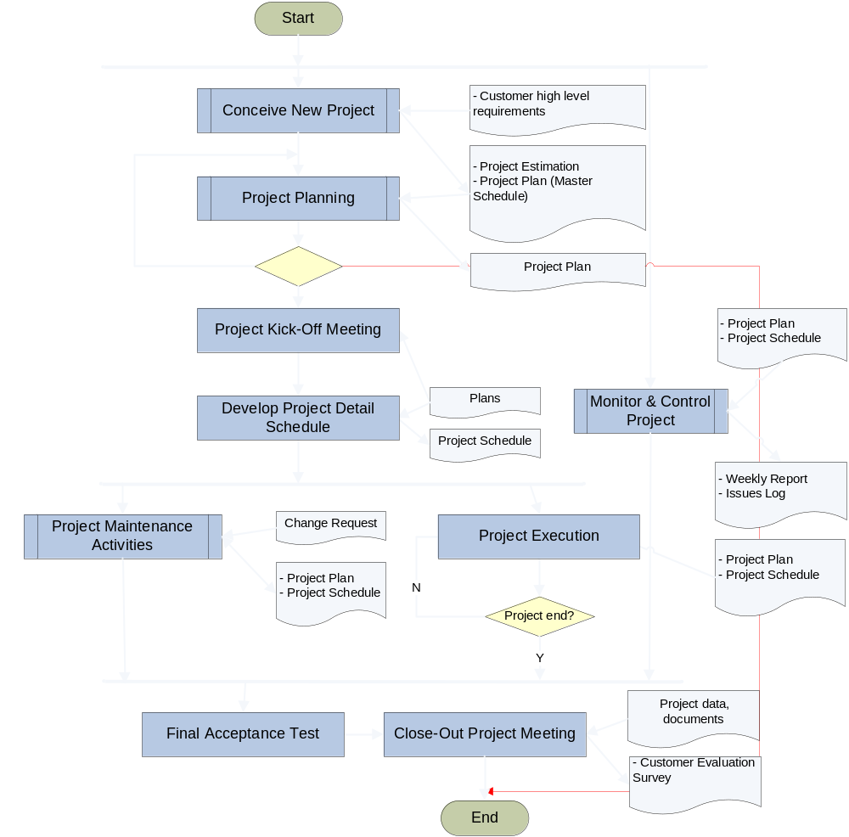
MANAGEMENT PROCESS
OVERVIEW

Slide 3
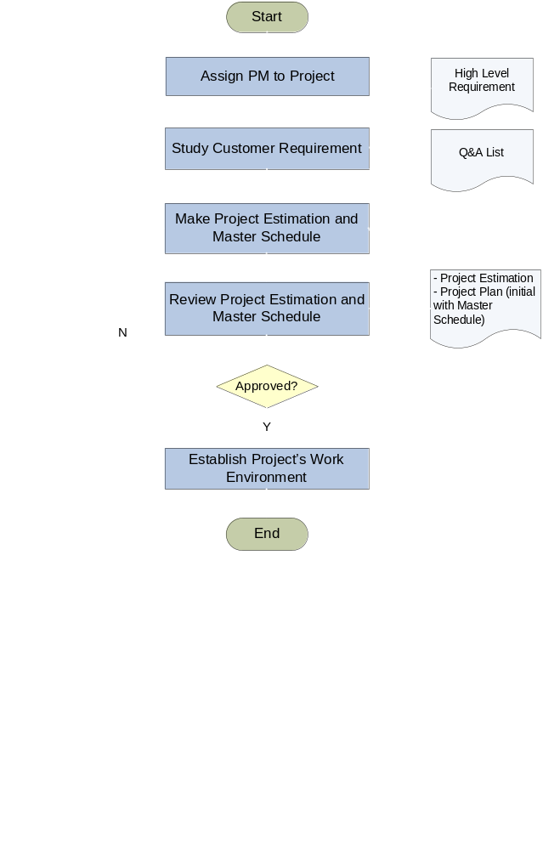
Conceive New Project
Back to Overview

Slide 4
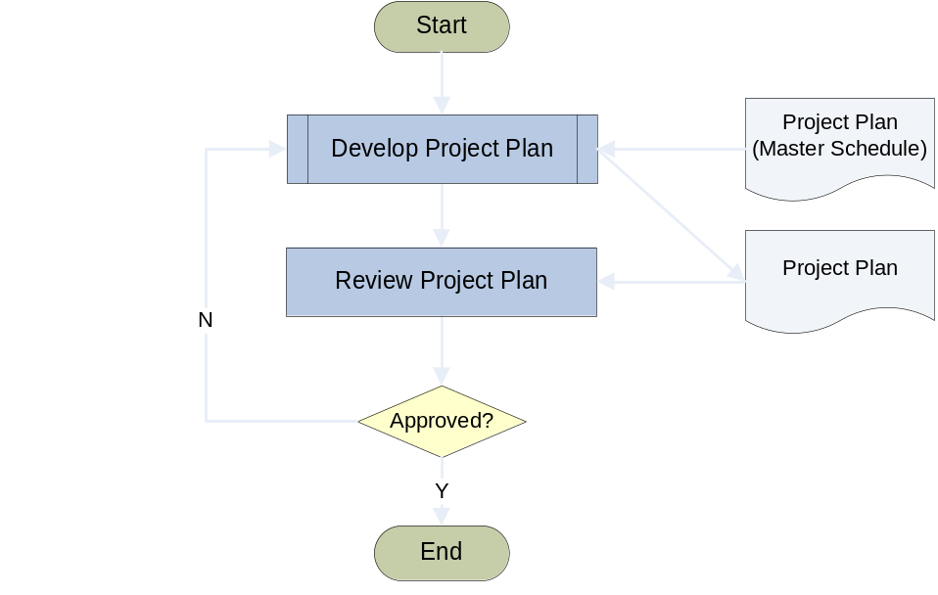
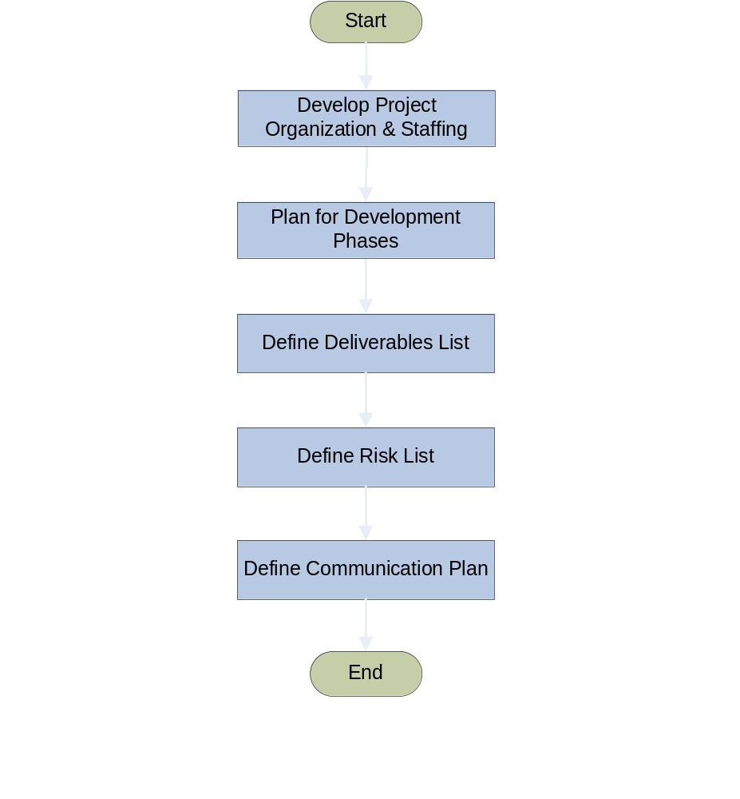
Project Planning
Develop Project Plan
Back to Overview

Slide 5
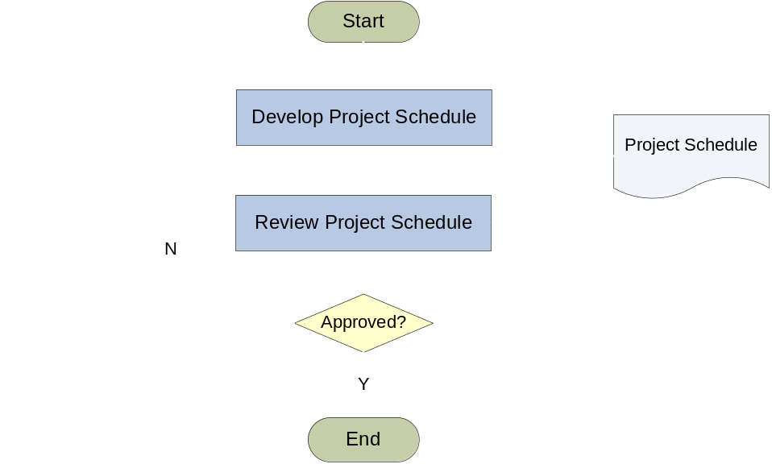
Develop Detail Schedule
Back to Overview

Slide 6
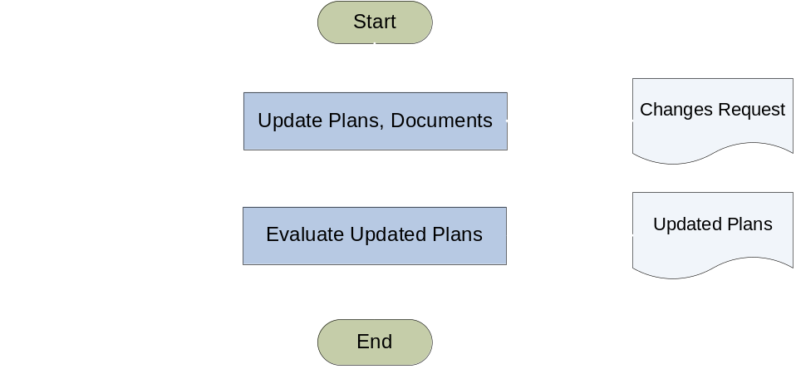
Project Maintenance Activities
Back to Overview

Slide 7
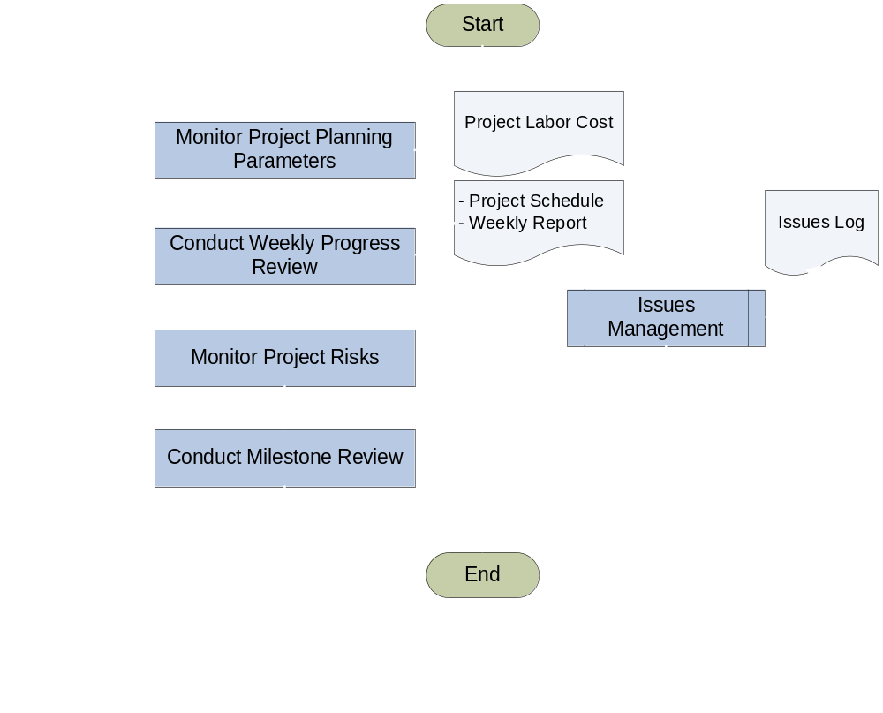
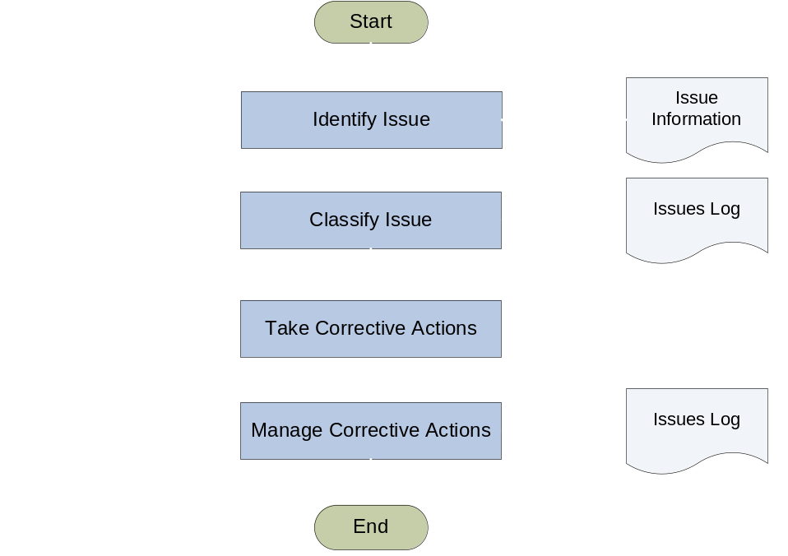
Monitor & Control Project
Issue Management
Back to Overview

Slide 8
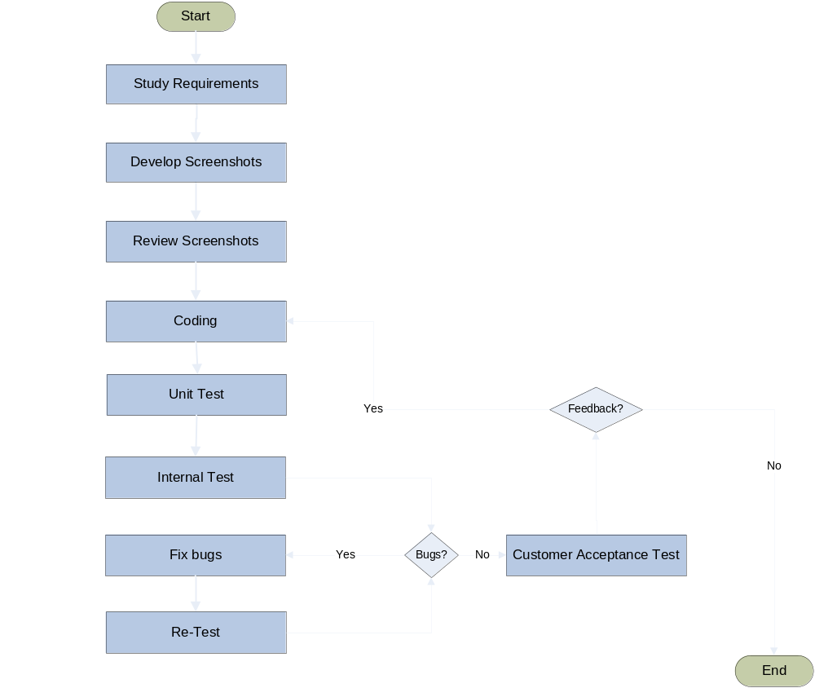
DEVELOPING & TESTING PROCESS
This Process will be repeated
for each product’s feature.
Back to Overview

Slide 9
The End

